Slide 1

UNIT-1
G.Ravindra Bharathi

Slide 2
Contents
Electronic Commerce - Frame work
Anatomy of E-Commerce applications
E-Commerce Consumer applications
E-Commerce Organization applications
Consumer Oriented Electronic commerce - Mercantile Process models.

Slide 3
Anatomy Of E-commerce Applications
E-commerce applications constitutes for different types of elements which are :
Multimedia content for E-Commerce Applications
Multimedia Storage Servers & E-Commerce Applications
i. Client-server architecture in E-Commerce
ii. Internal processes of Multimedia servers
iii. Video servers & E-Commerce
Information delivery/transport & E-Commerce Applications
Consumer Access Devices

Slide 4
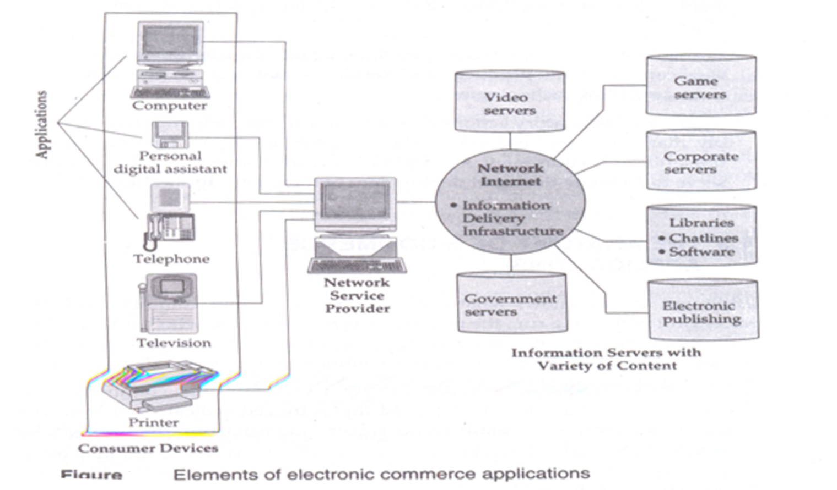

Slide 5
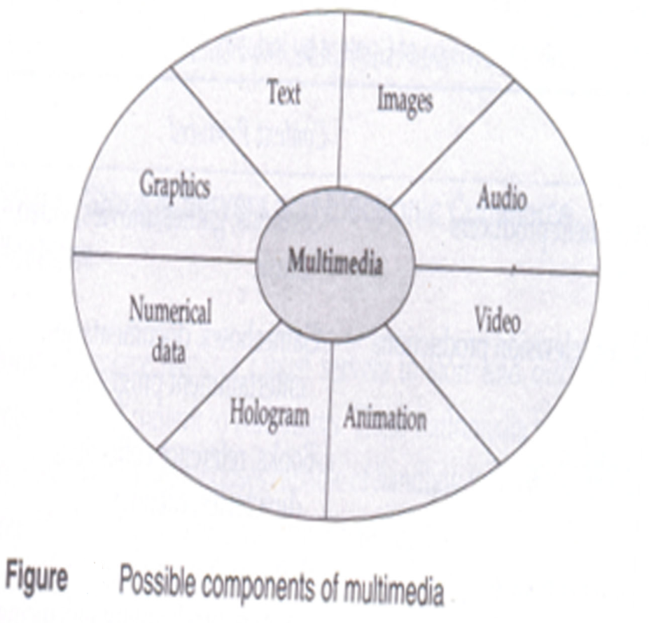
1. Multimedia Content for E-Commerce Applications
The technical definition of multimedia is the use of digital data in more than one format, such as the combination of text, audio, video, and graphics in a computer file/document.
Multimedia content can be considered both fuel and traffic for electronic commerce applications.
Multimedia has become to mean the combination of computers, television, and telephone capabilities in a single device.

Slide 6
The term multimedia covers so many things that it is often difficult to conceptualize and adding to this, telecommunications, cable/broadcasters, computer software and hardware providers each have a different view of what multimedia means.
Industry | Content Produced
Entertainment producers | Cartoons, games, movies Video, Music
Broadcast television productions | Game shows, documentaries, Entertainment Programs
Print publishing catalogues | Books, reference collections,, directories,
Computer software | Software programs: animation, games, productivity-enhancing tools
Table : Traditional Division of Content by Industry.
The success of e-commerce applications also depends on the variety and innovativeness of multimedia content and packaging.

Slide 7
2. Multimedia Storage Servers and Electronic Commerce Applications
Electronic commerce requires robust servers to store and distribute large amounts of digital content to consumers.
These multimedia storage servers are large information warehouses capable of handling various content, ranging from books, newspapers, advertisement catalogues, movies, games, and x-ray images.
These servers, deriving their name because they serve information upon request, must handle large-scale distribution, guarantee security, and complete reliability.
Digitized content eliminates the bulkiness and mechanical unreliability found in past equipment.
Steady advances in digital memory technology are making mass-storage devices technologically feasible and increasingly cost effective.

Slide 8
i. Client-Server Architecture in Electronic Commerce
Almost all e-commerce applications follow the client-sever model. Clients are devices plus software that request information from servers.
The client-server model replaces traditional mainframe-based models that worked will for a long time.
The client-server model, allows the client to interact with the sever through a request-reply sequence governed by a paradigm known as message passing.
The server manages application tasks, handles storage and security, and provides scalability-ability to add more clients as needed for serving more customers.
In effect, the multimedia server handles the critical elements (distribution, connectivity, security, accounting), and so is expected to simplify and make scaling more cost-effective.

Slide 9
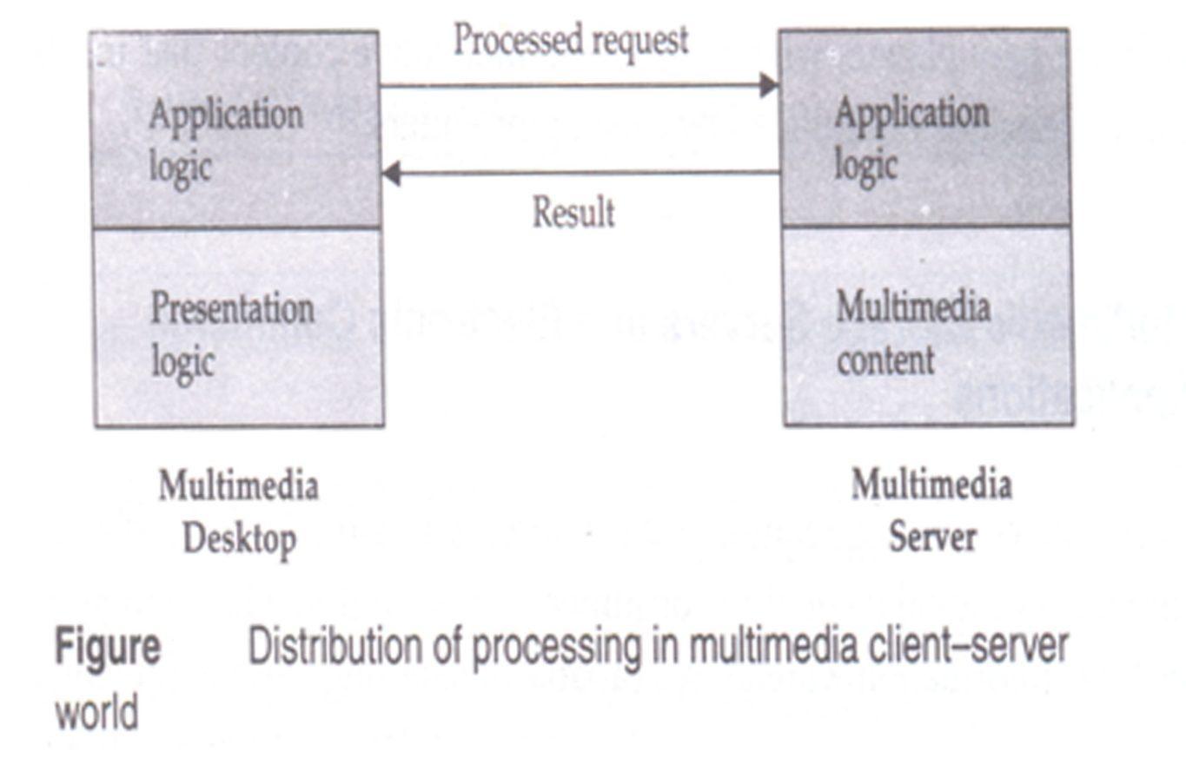

Slide 10
ii. Internal Processes of Multimedia Servers
The internal processes of a multimedia servers involves the storage, retrieval, and management of multimedia data objects.
These servers have different uses:
It captures, processes, manages, and delivers text, images, audio, and video.
Most multimedia servers provide a core set of functions to display, create, and manipulate multimedia documents;
To transmit and receive multimedia documents over computer networks, and to store and retrieve multimedia documents.

Slide 11
iii. Video Servers and Electronic Commerce
Video servers are an important link between the content providers (entertainment/ media) and transport providers (telcos/wireless/cable operators).
One important difference between video servers and the current client-server computer systems used extensively for data processing is that video severs are designed to deliver information to hundreds of consumers simultaneously via public telecommunications and cable networks.
Video servers tackle the "simultaneous overlapping" supply problem that arises when providing on-demand services to large numbers of home. Numerous households will want to watch the film either simultaneously or at overlapping times. This problem can be approached from either the hardware or software end.

Slide 12
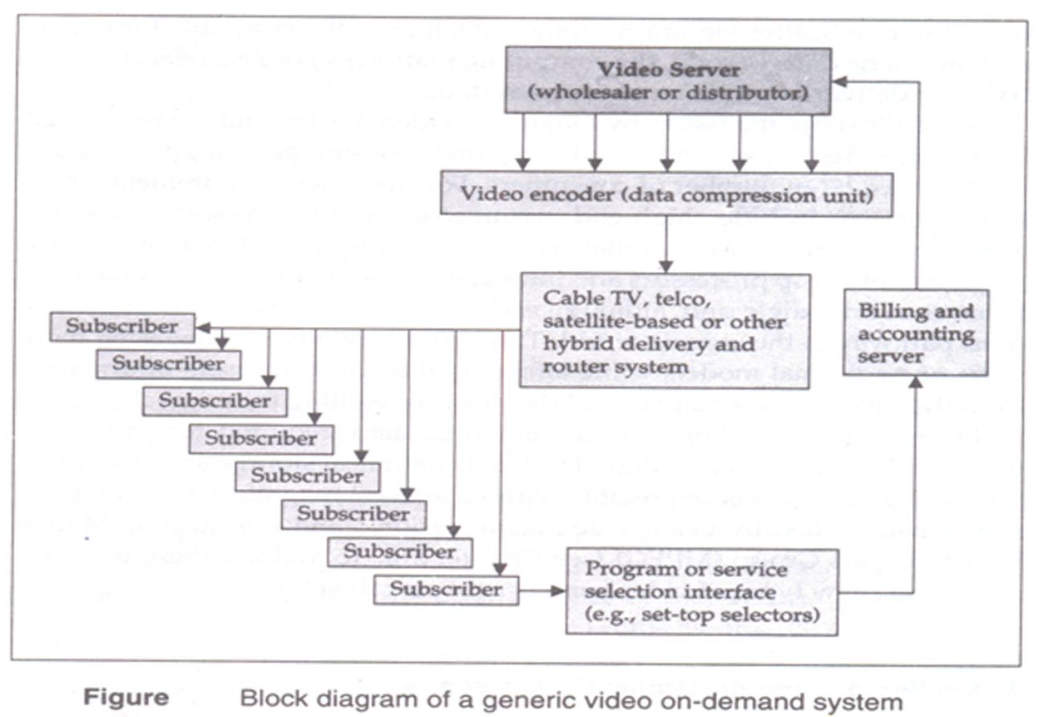
All video servers need not be hardware-based.

Slide 13
3. Information Delivery/Transport and E-Commerce Applications
Information Delivery / transport in e-commerce application involves how the data is moved through the media and the type of transport providers.
Transport providers are :
Telecom Based
Cable-based
Computer network-based
Wireless

Slide 14
4. Consumer Access Devices
How the majority of users will access e-commerce applications, as yet unknown, is heavily linked to the access device they opt to use. A myriad of devices can provide access to information: videophones, PCs capable of handling multimedia, personal digital assistants like Apple's Newton, televisions capable of two-way transmission, cellular phones, mobile and portable computers.
Consumer access devices focuses on two important processes
Different types of customers for different information.
Devices required for customers for different information.

Slide 15
The four main types of information customers and different access devices required by them are shown in below table :
Information Consumers | Access Devices
Computers with audio and video | Personal /desktop computing
capabilities | (workstations, multimedia PC)
 | Mobile computing (laptop and
 | notebook)
 | CD-ROM-equipped computers.
Telephone devices | Videophone
Consumer electronics | Television + set-top box Game
 | Systems
Personal digital assistants (PDAs) | Pen-based computing Voice-driven
 | computing Software agents.

